Slide 1

Internet of Things Innovation: Future for Retail
Presented to you By: Amir Shukri

Slide 2
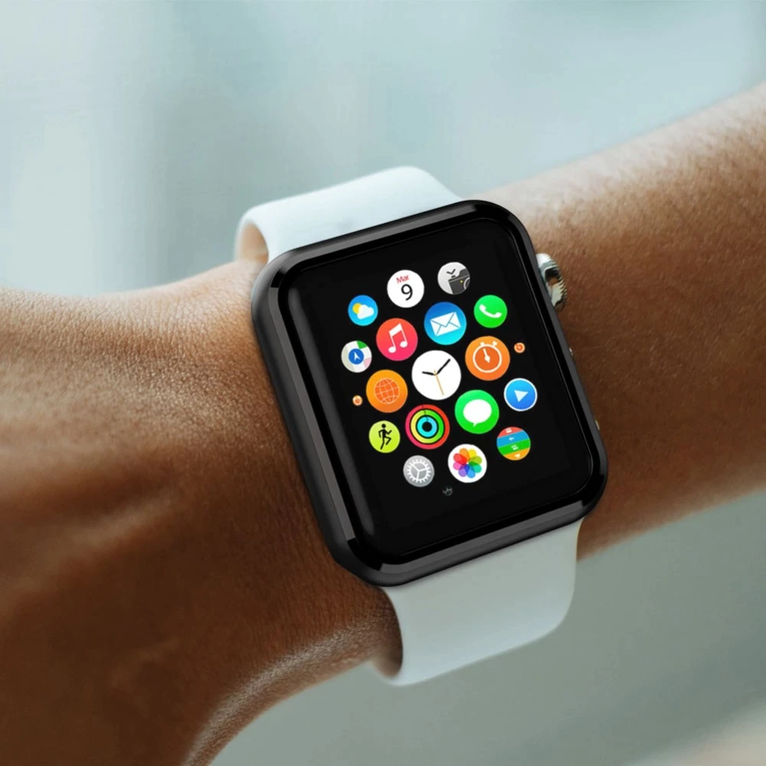
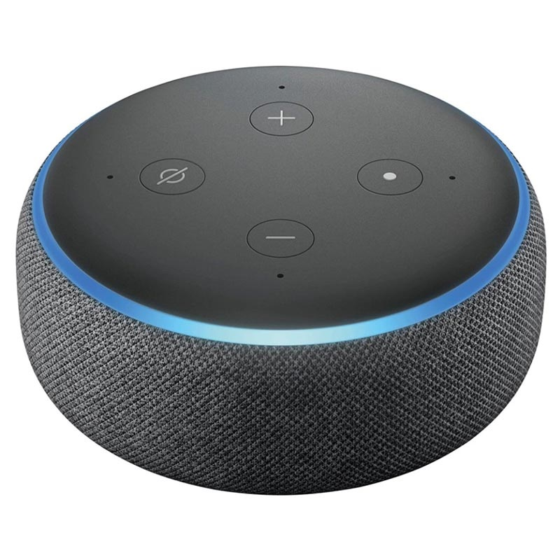
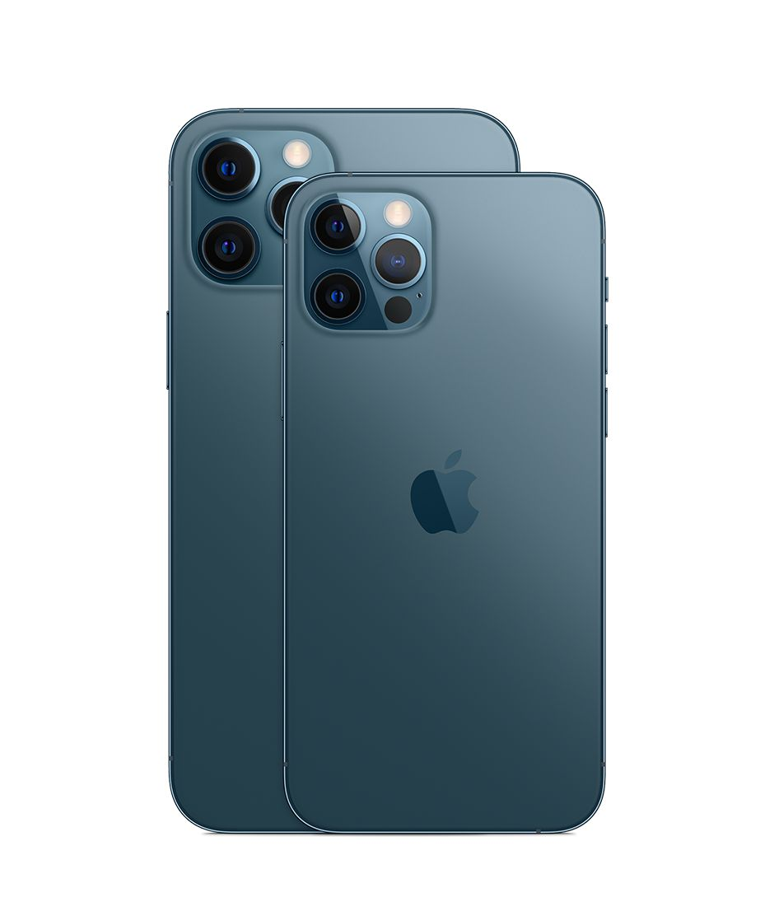
What is The Internet of Things (IoT)?

Slide 3
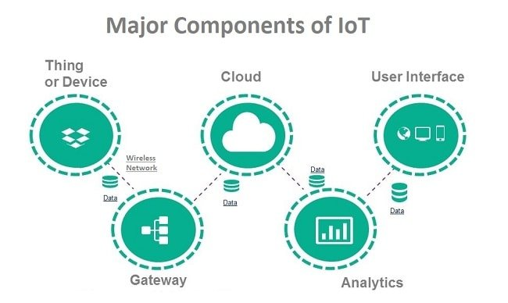
How it works

Slide 4
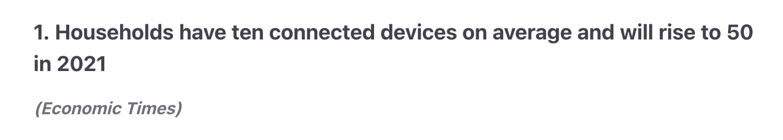
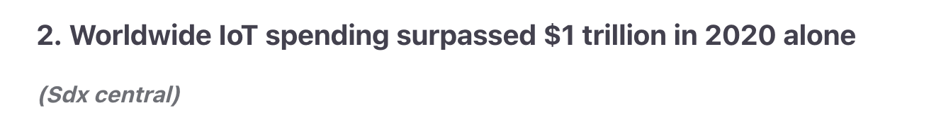
Why Iot is important for your Business?

Slide 5
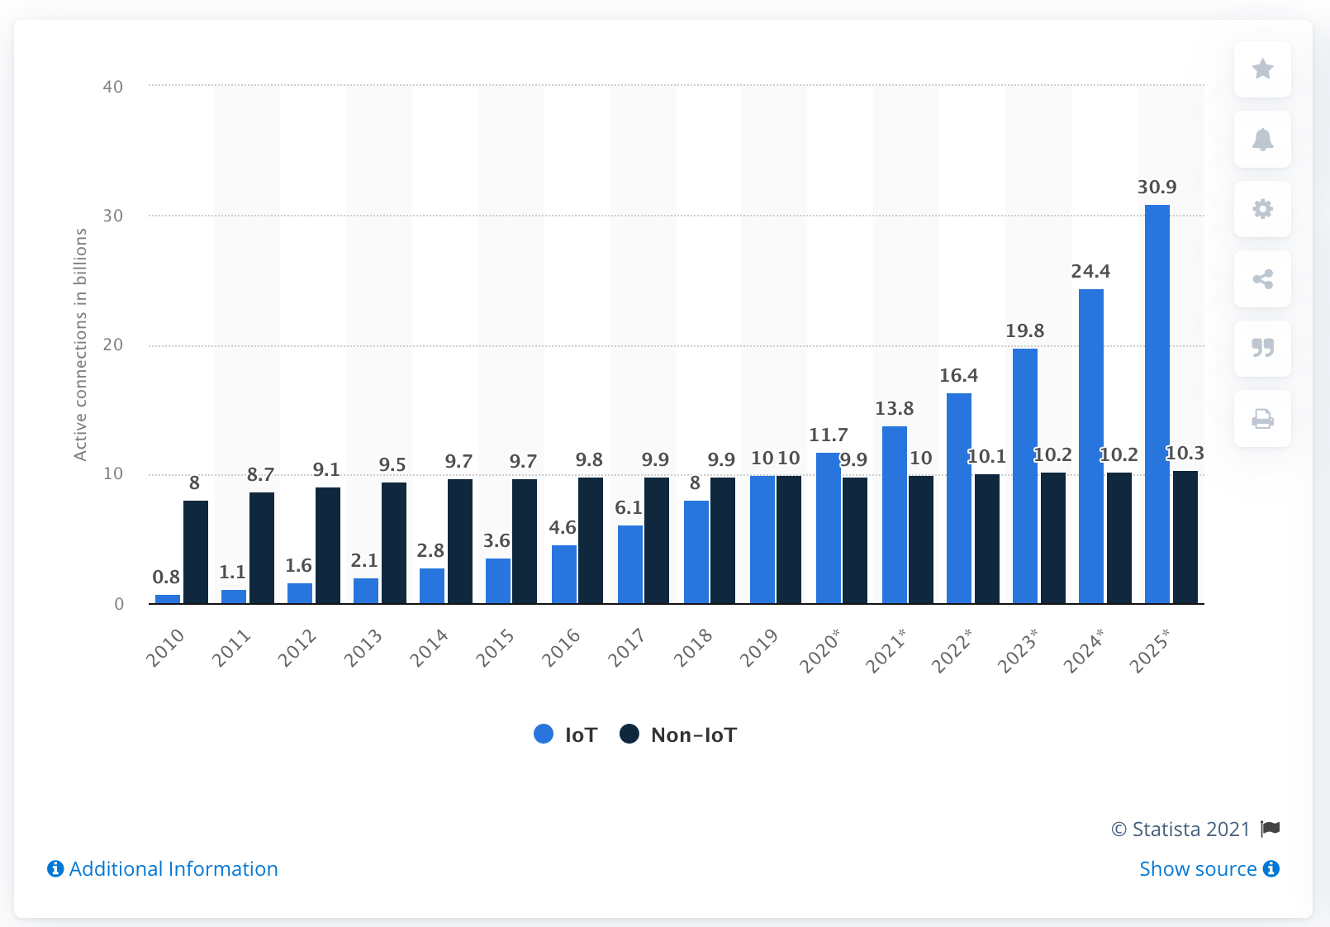
Growth Projections for IOT (in billions)

Slide 6
Understanding foot traffic
Measuring the movement of people within a given space. Particularly relevant to gauge people coming in and out of stores.
Important to:
Understand customer behaviour
Optimise staffing
Measure and quantify marketing campaigns
Understand impact of external factors

Slide 7
Factors affecting Foot traffic
Weather
Economy
Consumer Demand and Trends
Seasonality
Marketing Campaigns
Location

Slide 8
Problem Statement
What technologies within the IoT space can assist with understanding foot traffic analytics and consumer behaviour?

Slide 9
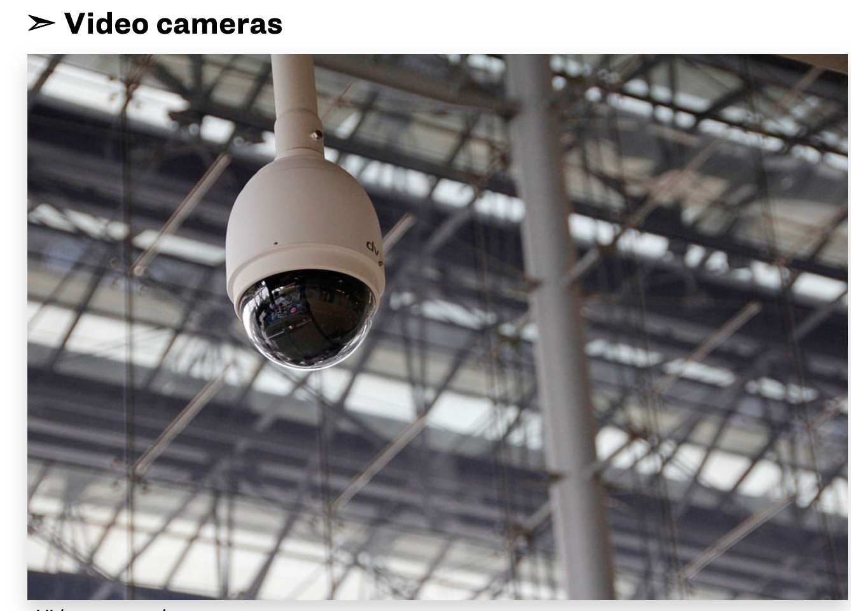
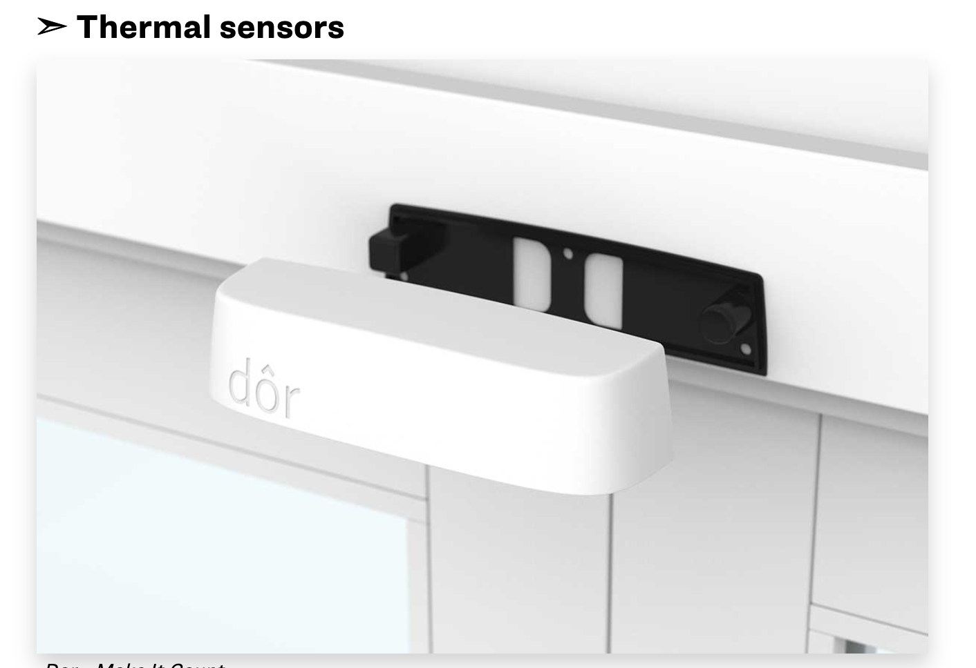
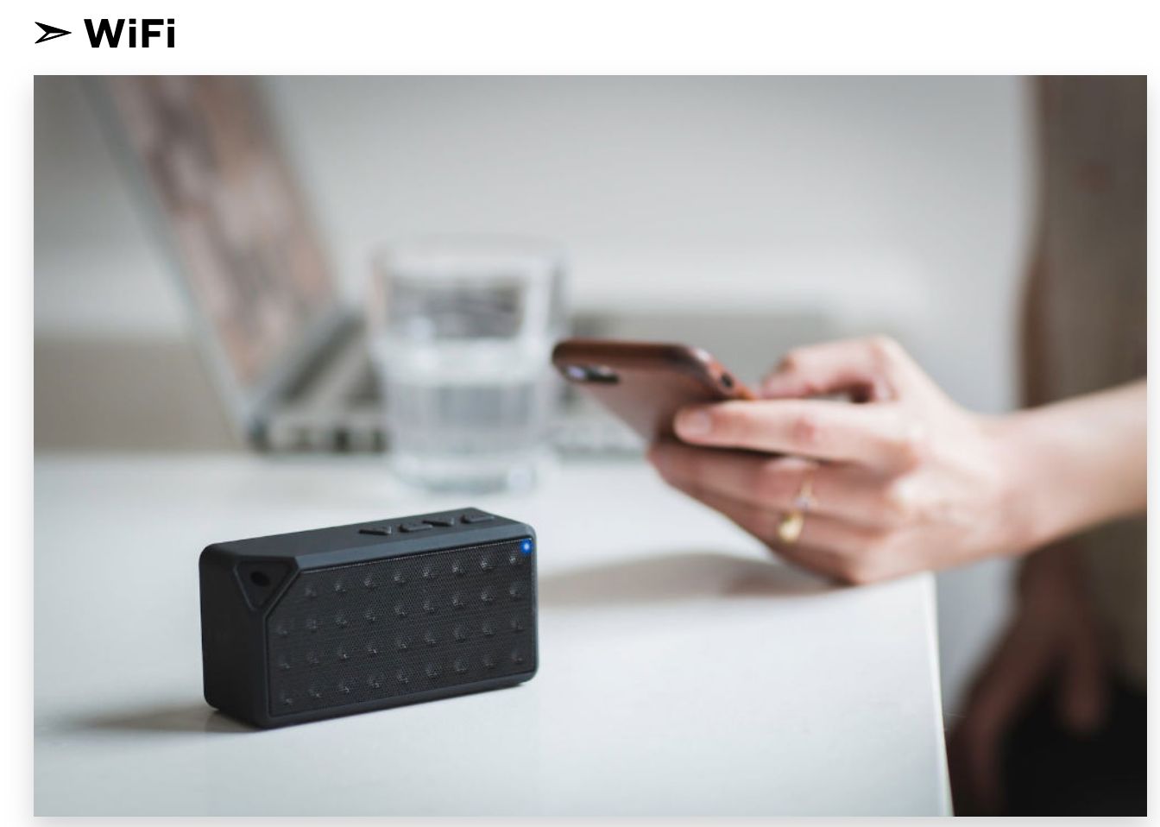
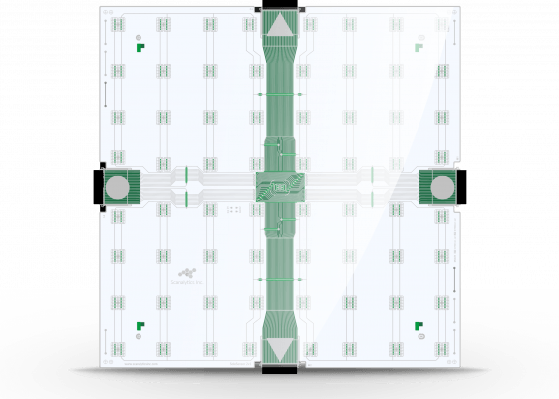
Technologies for foot traffic
Beam Sensors
Thermal Sensors
Pressure Sensors
Wifi Counting
Video Analytics

Slide 10
Factors when Choosing technology
Does it integrate with the existing system well?
Exactly what data are you getting and how useful is it to your business?
How expensive is the solution?
How easily can it integrate to your current system?
Does it violate customer privacy regulations?

Slide 11
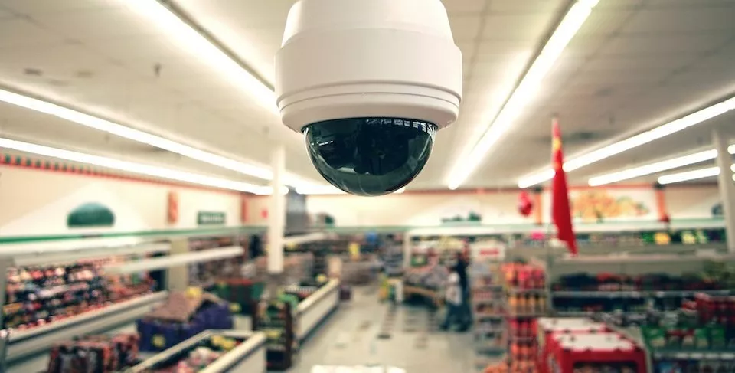
Video cameras: the most accurate
High accuracy
Potentially can be integrated to existing security system to monitor in-store activity by installing video analytics algorithm.
Avoid privacy issues compared to wifi counting method, information anonymised while giving accurate footfall and dwell time.
Only downside is its expensive costs.

Slide 12
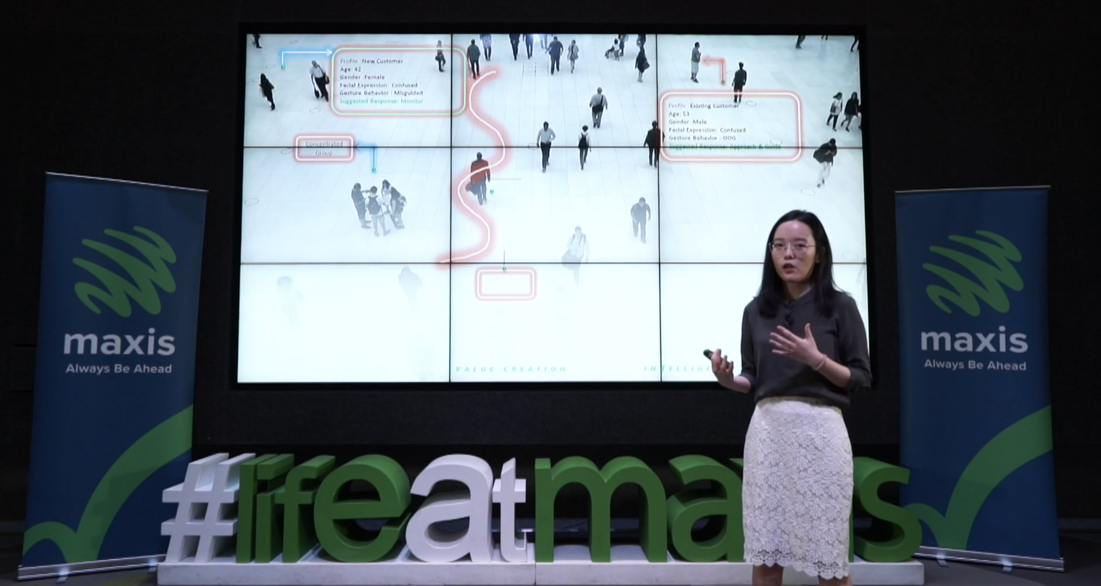
How maxis uses People counting technology

Slide 13
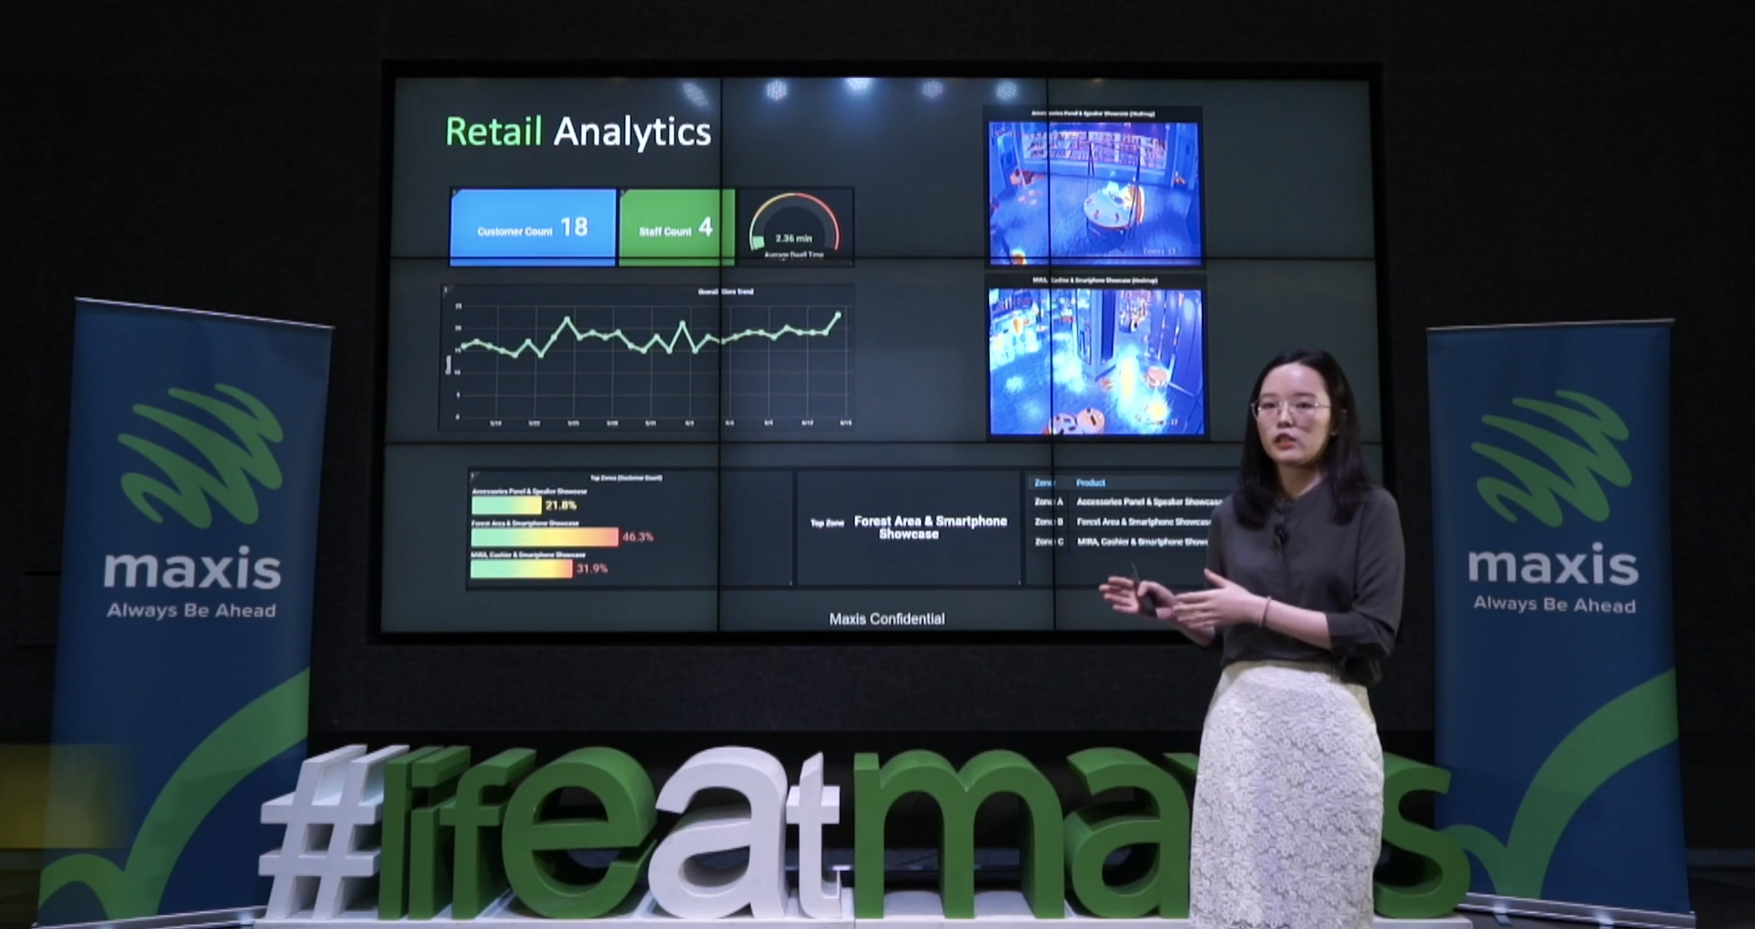
Further Implementations: Heat Maps and Zone analytics

Slide 14
Foot traffic with IOT
A Step in the right Direction
Amir Shukri, 2021

